Slide 2
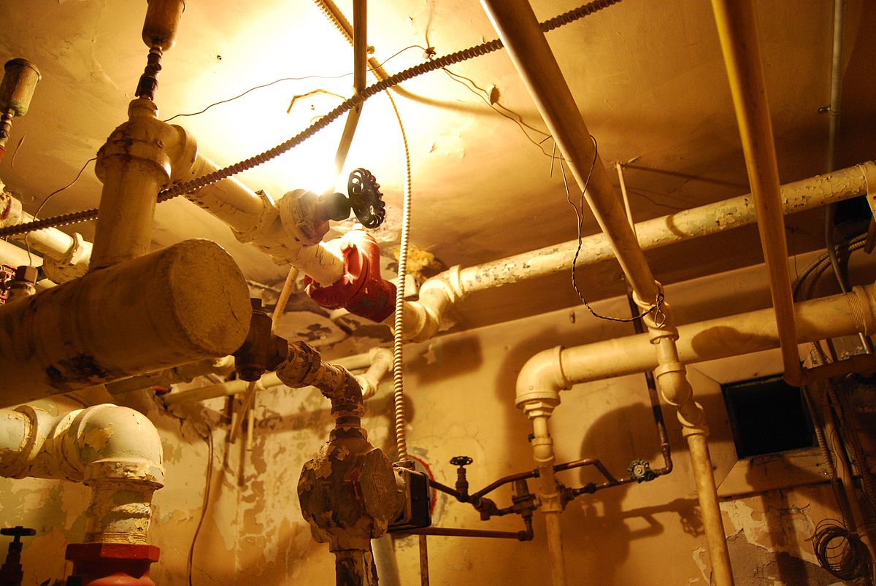
20 OCTOBER 2017
Faucet Architecture
And future direction
Notes:
House plumbing

Slide 3
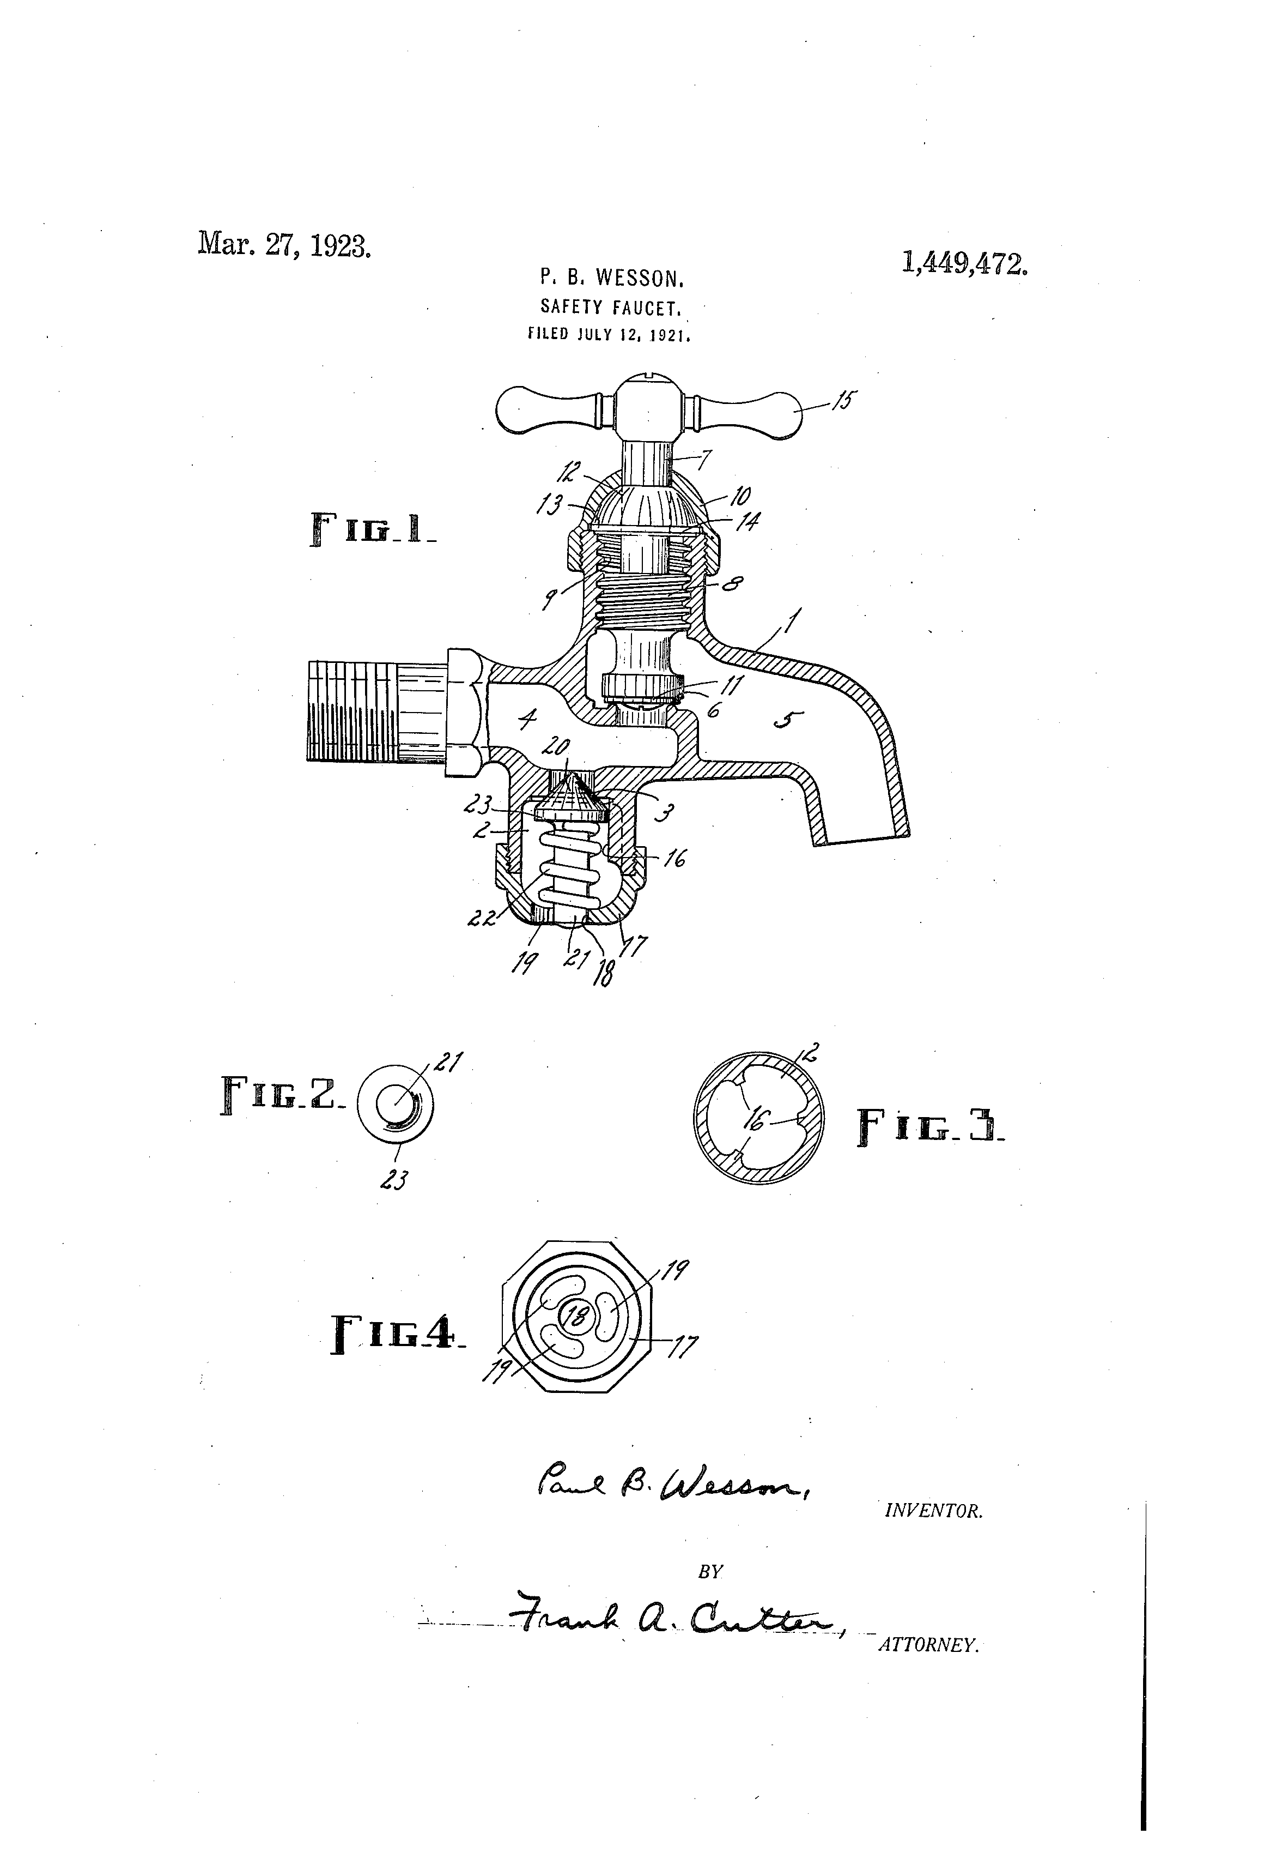
Design Philosophy

Slide 4
Philosophy
Worlds Simplest Production SDN
Controller
Easy to deploy
Easy to operate
Easy to modify
Easy to support
Faucet Conference 2017-10-20
4
Notes:
Should be able to be done by a network engineer

Slide 5
Philosophy
SDN
Portable across Vendors
Not hampered by maintaining drivers
Open
Fine-grained
OpenFlow 1.3
Follow the spec
Test against OVS–if OVS can’t support it neither can we
Faucet Conference 2017-10-20
5

Slide 6
Philosophy
Still gotta switch packets
Reliability
Monitoring
Interop
Faucet Conference 2017-10-20
6
Notes:
Would our network engineer be willing to use it

Slide 7
Philosophy
not The Kitchen Sink
We mostly stick to the fundamentals
Switching
VLANs
ACLs
L3 FIB
Primitives that protocols can build on top of
Faucet Conference 2017-10-20
7
Notes:
Code execution path should be reasonably easy to understand so that when something weird is going on a network engineer can work out why
We only want to worry about the features that we are using. If we arent using it we want to be confident it isnt going to interfere with our network.

Slide 8
Philosophy
Lightweight, not empty
Unfortunately we do need some protocols
BGP
Stacking
Security Features
LACP
Ideally modular, so they can be isolated when not in use
Faucet Conference 2017-10-20
8

Slide 9
Philosophy
Reliable Data Plane, Unreliable Control Plane
Fail-secure mode
If you need controller reliability use two of them
YMMV at the moment
We’re working on it (or you could!)
Faucet Conference 2017-10-20
9
Notes:
What is fail-secure mode

Slide 10
Philosophy
State
Persistent state is stored in configuration
Everything else is ephemeral
Next hop resolution
L2 Learning
If in doubt throw it out
Faucet Conference 2017-10-20
10
Notes:
If we could make an entirely stateless network we would

Slide 11
Philosophy
Configuration
Changing configuration breaks peoples networks–so we should* get it right the first time
* Probably won’t
Faucet Conference 2017-10-20
11

Slide 12

Control Channel

Slide 13
Control Channel
Risk of drowning
Ideally no network traffic would ever touch control channel
Unfortunately, we do have to look at some packets sometimes
Controller cannot fix an overwhelmed control channel
Faucet Conference 2017-10-20
13

Slide 14
Control Channel
Rate-Limiting
CP traffic rate-limited at controller
Ideally would be done on switch
Faucet Conference 2017-10-20
14
Notes:
Metering not supported by OVS, cant use it

Slide 15
Control Channel
Solution (ToDO)
Network traffic to the CP comes via a second channel
Auxiliary channels not necessary, just forward packets
No guarantee Auxiliary channels would save you
Faucet Conference 2017-10-20
15

Slide 16
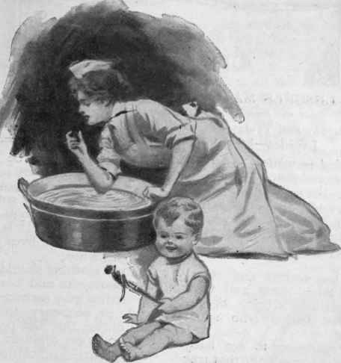
Tests

Slide 17
Tests
Unit tests and Integration tests
We have good integration tests
Sometimes called unit tests
We have some unit tests
This needs to improve
Faucet Conference 2017-10-20
17
Notes:
Todo cut down this slide

Slide 18
Tests
Integration tests
Tests whole system
Focus on thoroughness
Slow to run (around 30 minutes)
Likely to overtake core code for total lines soon
Faucet Conference 2017-10-20
18

Slide 19
Tests
Unit tests
Aid development
Focus on accessibility
Quick to run
Trivial to write
Need a lot of work
Faucet Conference 2017-10-20
19

Slide 20
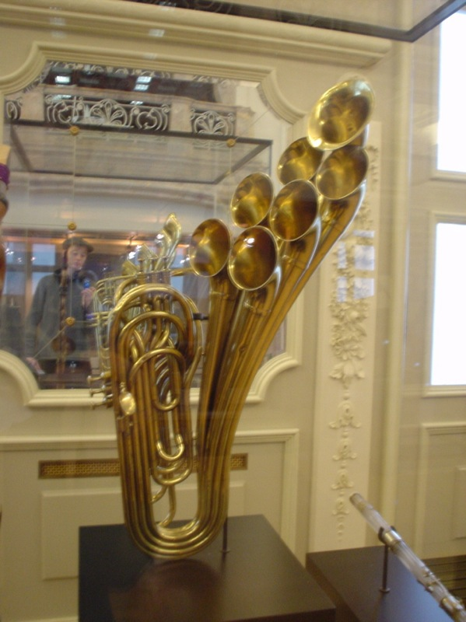
Plumbing
By Charles Hutchins (Flickr: 7 Bells) [CC BY 2.0 (http://creativecommons.org/licenses/by/2.0)], via Wikimedia Commons
Notes:
By Charles Hutchins (Flickr: 7 Bells) [CC BY 2.0 (http://creativecommons.org/licenses/by/2.0)], via Wikimedia Commons

Slide 21
Structure
Faucet vs Gauge
Monitoring and control are separate functions
Gauge can monitor any OpenFlow 1.3 application
Faucet Conference 2017-10-20
21

Slide 22
Faucet
Valve
Sticks things together
Interacts with Ryu
Logic for one datapath
Little interaction with Ryu

Slide 23
Structure
Gauge vs Watcher
Similar structure to Faucet and Valve
A Watcher is the logic to monitor a single statistic on a single datapath
Eg. Port Statistics on office-faucet
Faucet Conference 2017-10-20
23
Notes:
Watcher config and watcher class subtly different

Slide 24
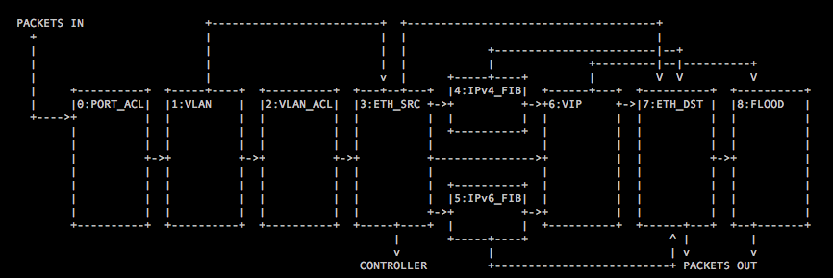
Structure
Pipeline
Faucet Conference 2017-10-20
24
Notes:
Port ACL
default drop
apply acls
send to vlan table
VLAN table
filter specific protocols
check and apply tagging
send to vlan_acl or eth_src
VLAN_ACL
pretty obvious
Eth_src
sends packets for our ethernet destination to FIB
sends arp to VIP
identify packets where ethernet src is known
send others to controller for learning AND forward them to eth dst
probably a little bit too overloaded
synchronising eth_src and eth_dst is a big challenge
FIBS
default drop
route packets
rewrite ethernet destination
send to eth_dst table for output
VIP
filter control plane traffic
ARP, ICMP, ICMPv6
also packets for proactive learning
Eth dst
output packets when known
Flood table
entry for each port on each vlan
shouldn’t be necessary, openflow spec is slightly ambiguous, but intention is clear. Packets should not be output inport.
or use groups

Slide 25

Future

Slide 26
Future
High availability
OpenFlow Spec isn’t great on this one
Active/standby controllers would be nice
dp choses master
Spec wants controllers to determine master not dp
Faucet Conference 2017-10-20
26
Notes:
Be generic, follow openflow spec

Slide 27
Future
API
Northward: Broadcast information
Southward: Idempotent commands
Each controller has a single master
Controllers should* agree
* Probably won’t
Faucet Conference 2017-10-20
27
Notes:
Avoid introducing new state (is my API channel functioning)
Don’t expect anything to your north to protect you from something from your south

Slide 28
Future
Virtualisation
Currently routing virtualisation is done with VLANs
Fairly inefficient
Need to move to using metadata
Faucet Conference 2017-10-20
28
Notes:
Avoid introducing new state (is my API channel functioning)

Slide 30
bonus
Stacking
Static loop protection
Shortest path forwarding
In-rack rather than across LAN
Faucet Conference 2017-10-20
30

Slide 31
bonus
L2 Learning
Two Modes:
use_idle_timeout: True
use_idle_timeout: False
Entries must never exist in the SRC_MAC table if they aren’t also in the DST_MAC table
Faucet Conference 2017-10-20
31

Slide 32
bonus
Default learning
ETH_SRC table:
Hard timeout
ETH_DST table:
Idle timeout
More CP traffic, but better synchronisation
Faucet Conference 2017-10-20
32

Slide 33
bonus
Use_idle_timeout learning
Use host cache to keep track of flows.
ETH_SRC rule times out:
mark cache entry as expired
ETH_DST times out:
if cache entry not expired reinstall it
Flows are removed once both src and dst rules time out
Fewer CP messages, but more risk of tables getting out of synch
Faucet Conference 2017-10-20
33

Slide 34
bonus
Neighbour resolution
Cycle through list of next hops attempting to resolve each
Directly connected hosts are added to next hop list whenever we see a packet from them (for any reason)
Will already be resolved
Directly connected hosts removed when they can no longer be resolved
Faucet Conference 2017-10-20
34
Notes:
Dual stack network is a problem
Ipv6 privacy extensions are n even bigger problem

Slide 35
bonus
Proactive Learn
When a packet cannot be routed because directly connected host is not resolved, send it to the controller
Destination added to next hop list
Causes more traffic to the controller
Faucet Conference 2017-10-20
35

Slide 36
Bonus
PORT_ACL table
Default Drop
ACLs filter traffic
Accepted traffic goes to VLAN table
Faucet Conference 2017-10-20
36

Slide 37
Bonus
VLAN TAble
Default Drop
Filter out certain protocols (LLDP, STP BPDUs etc.)
Accept correctly tagged packets
If untagged packet on untagged port, push appropriate VLAN tag
Forward to VLAN_ACL table
Faucet Conference 2017-10-20
37

Slide 38
Bonus
VLAN_ACL TAble
Similar to PORT_ACL table
Forward to ETH_SRC table
Faucet Conference 2017-10-20
38

Slide 39
Bonus
ETH_DST Table
Forward packets with known Ethernet destination addresses
With correct VLAN tagging
Default send to FLOOD table
Faucet Conference 2017-10-20
39

Slide 40
Bonus
IPV#_FIB TableS
Default drop
Routes
Rewrite Ethernet destination
Set correct VLAN tagging
Output
Faucet Conference 2017-10-20
40

Slide 41
Bonus
VIP Table
Filters control plane traffic
ARP
ICMP
Unmatched traffic to directly connected hosts if using proactive_learn
Default drop
Faucet Conference 2017-10-20
41

Slide 42
Bonus
ETH_SRC Table
Forward termination packets to appropriate FIB tables
Entries identify packets where Ethernet source address does not need to be learnt.
Forward to ETH_DST table
Default send to controller AND forward to ETH_DST table
Could be
Faucet Conference 2017-10-20
42

Slide 43
Bonus
FLOOD table
Entries for each port on each VLAN outputting to each other port on the VLAN
This should not be necessary
OpenFlow spec is slightly ambiguous on this, but I think the intention is clear that packets should not be output to in port unless specifically output to OFPP_IN_PORT
Faucet Conference 2017-10-20
43

